Slide 1
Celebrating Christ’s Mercy
SSJ First Sacraments Retreat 2023

Slide 2
Original Sin

Slide 3
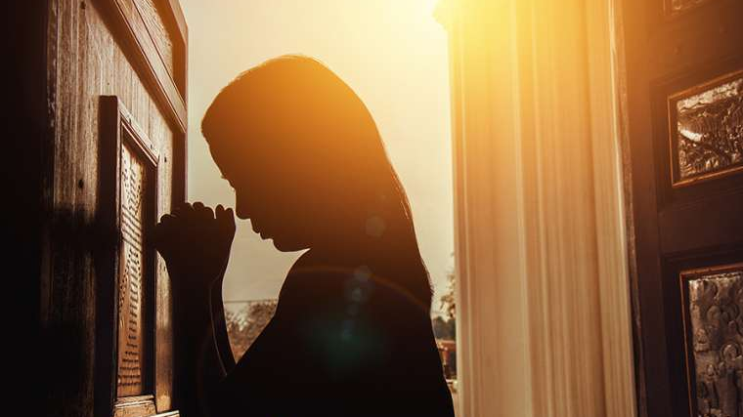
Sacrament of Reconciliation

Slide 4
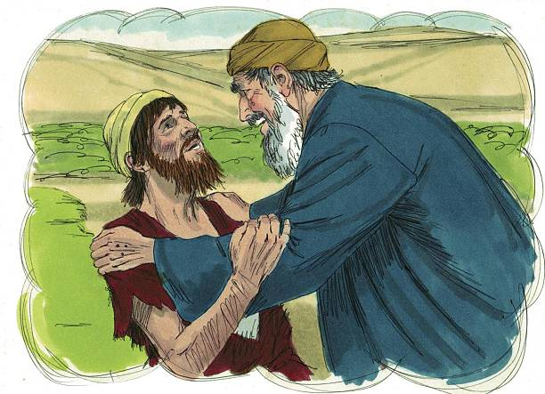
The Prodigal Son

Slide 5
Four elements of a good confession

Slide 6
CONTRITION
SORROW FOR OUR SINS

Slide 7
Confession Saying “I’m Sorry”

Slide 8
ABSOLUTION RECEIVING GOD’S FORGIVENESS

Slide 9
PENANCE MAKING AMMENDS

Slide 10
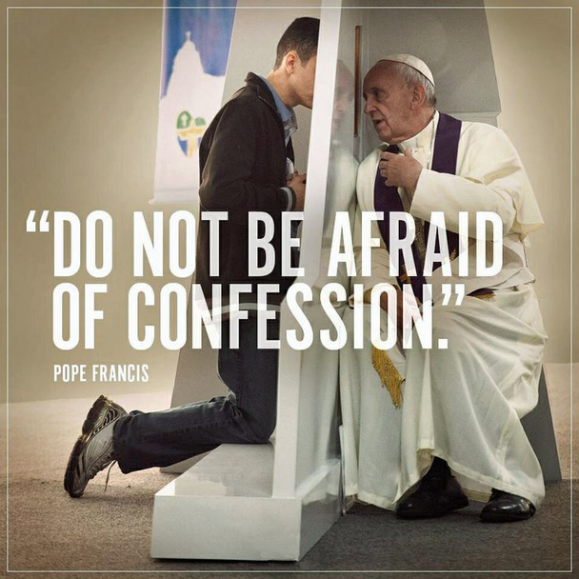

Slide 11
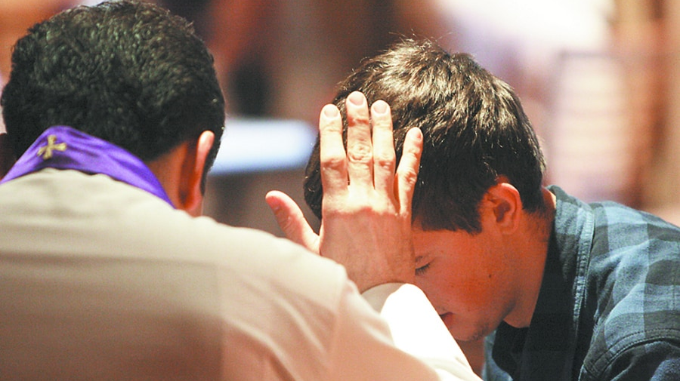
Reconciliation Role-Play

Slide 12
break

Slide 13
Celebrating Christ’s Presence
SSJ First Sacraments Retreat 2023

Slide 14
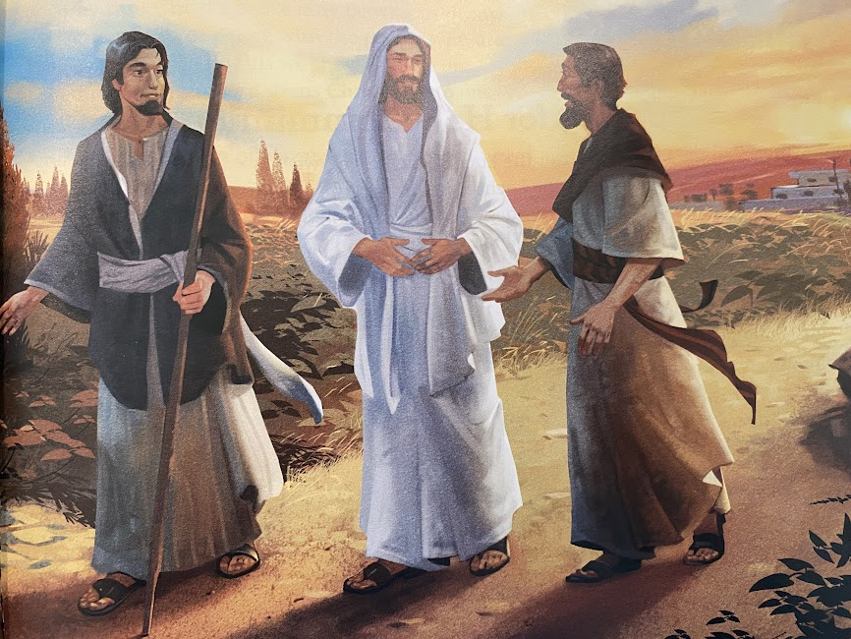
THE ROAD TO EMMAUS

Slide 15
Video

Slide 16
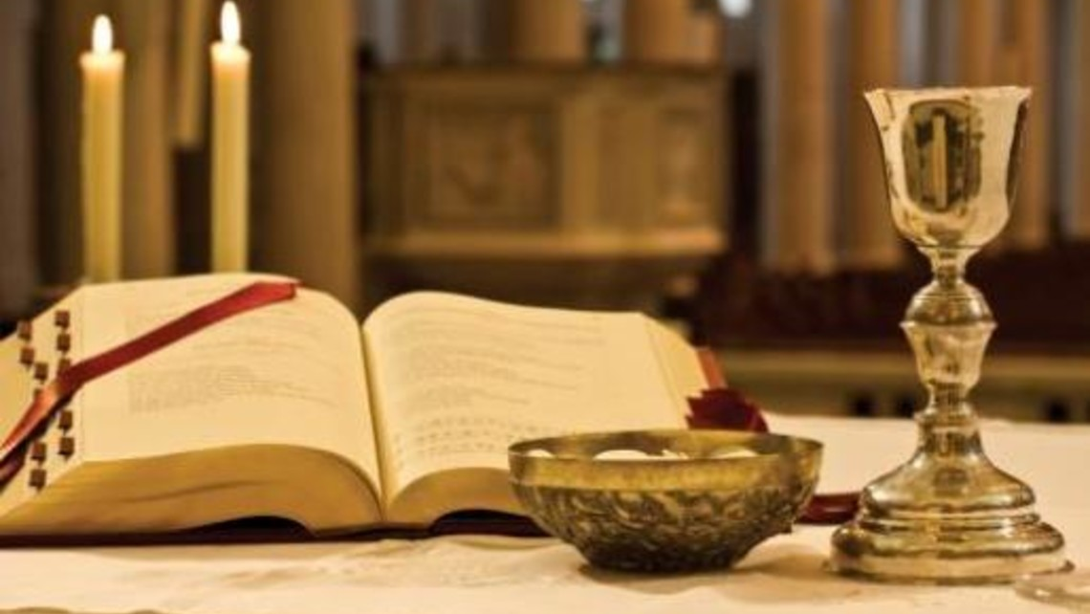
THE FOUR PARTS OF THE MASS

Slide 17
INTRODUCTORY RITE WE GIVE PRAISE AND GLORY TO GOD!

Slide 18
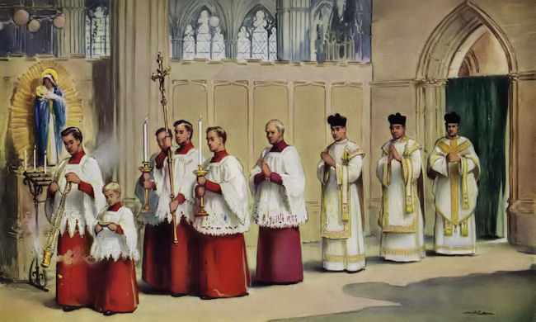

Slide 19
The liturgy of the word we listen to the word of god
Old Testament Reading
Psalm
New Testament Reading
Gospel
Homily

Slide 20
The liturgy of the Eucharist WE PREPARE OUR HEARTS AND MINDS TO RECEIVE JESUS

Slide 21
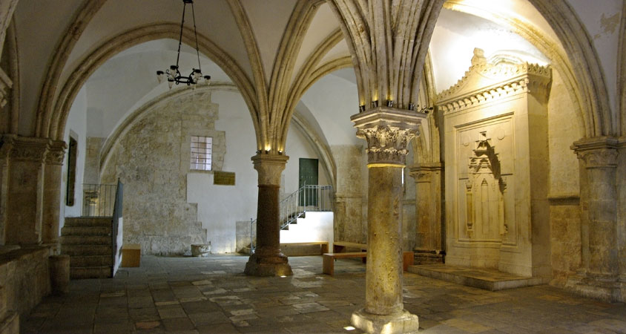
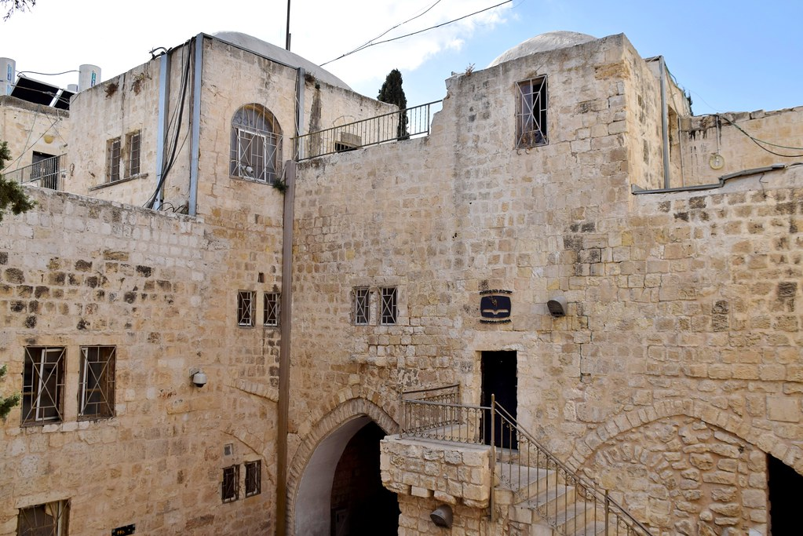

Slide 22
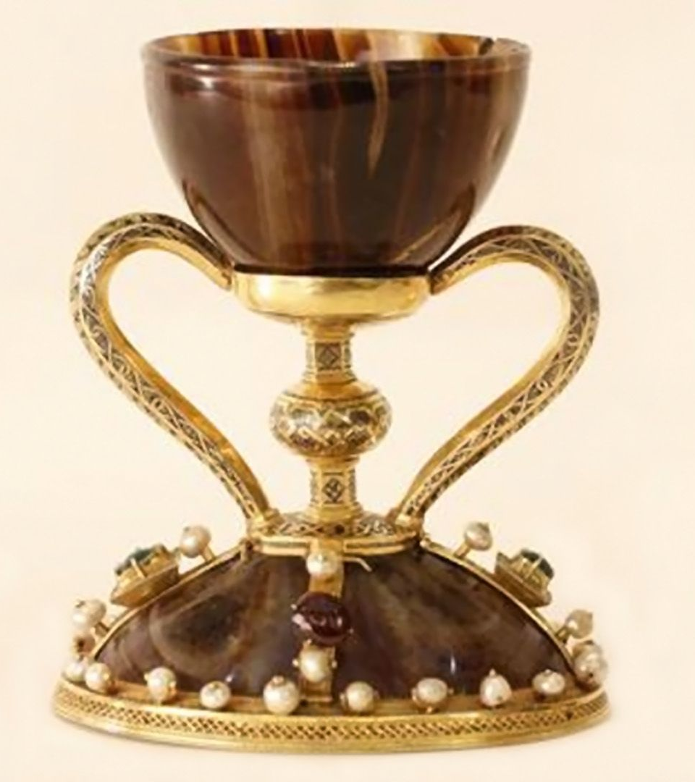
The chalice of valencia

Slide 23
Passover

Slide 24
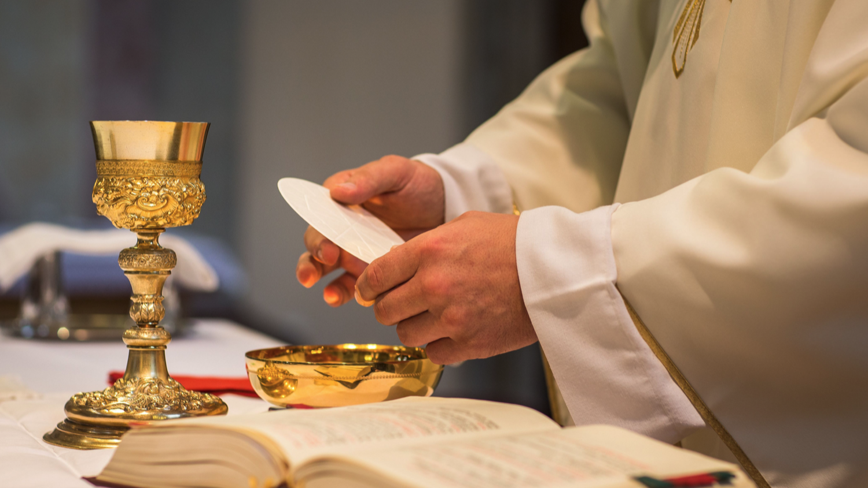

Slide 26
The concluding rite We go forth proclaiming the good news!

Slide 27
break

Slide 28
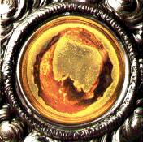
Lanciano, Italy 8th Century A.D.

Slide 29
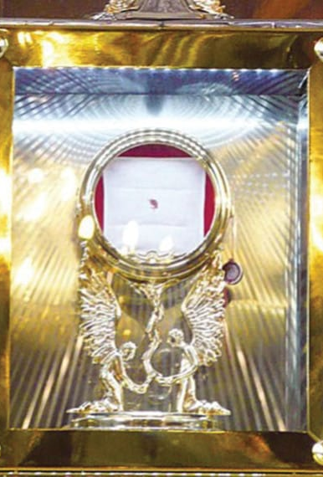
Legnica, Poland 2013 A.D.

Slide 30
Sacred vessels and mass objects

Slide 31
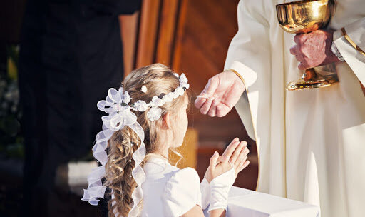
PRACTICE RECEIVING COMMUNION

Slide 33
Closing Prayer
Lord Jesus Christ,
Bless these children preparing to receive Holy Communion for the first time.
May this day be a step toward a life-long love of the Eucharist.
Give them a hunger for this sacred food so that they turn to you for comfort, guidance, and wisdom as they grow into full discipleship.
Thank you for their innocence and goodness.
May their hands, extended in anticipation of your body and blood, inspire all of us to cherish this sacred Sacrament. Amen.

